Slide 1


JAVA SE
(Core java)
Lecture 3

Slide 2

Today’s Agenda
Compiling And Executing The Code
Saving the source code
Compilation Process And It’s Explanation
Executing The Code
Discussion About Some Important Errors
Some More Concepts

Slide 3
Saving The Source Code
Once we have written the code, the next step is to save and compile it.
We can save our code in two locations:
Within “bin” subdirectory of jdk
OR
At any location in our machine
(This requires setting “PATH” variable also)
We will start with first approach and then migrate to second approach while learning about packages.

Slide 4
Saving The Source Code In “bin”
To save the code in “bin” , just choose jdk’s bin as the “location to save” in notepad.
In the “file name” option provide any name you like but with .java extension.
Generally we prefer giving the same name to our source code as the name of our class.(Remember it is a general choice not a rule!)

Slide 5
Saving The Source Code In “bin”
Also remember to give the filename in “double quotes” as otherwise notepad might add the extension .txt
Now since our class name is Test , so we would save our file by the name “Test.java”

Slide 6
Compiling The Source Code
To compile our code we have to do the following:
Open the command prompt by right clicking and selecting “run as administrator” option
Migrate to the jdk’s bin folder
C:\Document and settings\Admin\cd\
C:\cd ProgramFiles
C:\ProgramFiles>cd Java
C:\ProgramFiles>Java>cd Jdk 1.8.0
C:\ProgramFiles>Java>jdk 1.8.0>cd Bin
C:\ProgramFiles>Java>jdk 1.8.0>bin>
Type the command to compile the code

Slide 7
Compiling The Source Code
The general syntax of compilation is:
<javac > <full name of .java file>
javac is the name of java’s compiler which takes the name
of our source code as argument and generates the bytecode
For example:
javac Test.java
Remember this command has to be given from jdk’s “bin” folder as we have saved the file there only!

Slide 8
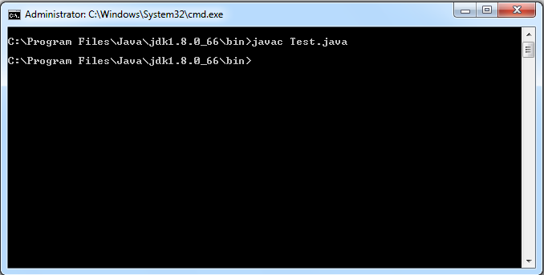
Compiling The Source Code

Slide 9
What happens when we compile our code ?
Whenever we compile our java code , the compiler does the following:
It checks for syntax errors (like missing semicolons,wrong class or method names etc)
If any syntax error is found the compilation stops.
Otherwise if no syntax errors are there the compiler generates the “bytecode” of our “source code”

Slide 10
Points To Remember About “bytecodes”
Bytecodes are generated as separate files.
These files have the extension .class and their name is same as the name of the class defined by the programmer.
For example if class name is Test , the bytecode name will also be “Test.class”
Number of bytecode files generated is same as number of programmer defined classes. So if our program contains three class called “College” , “Faculty” and “Student” , then three bytecode files would be generated called:
College.class
Faculty.class
Student.class

Slide 11
Executing The Code
The general syntax to run our code is:
java <Name of the class containing main method>
java is the Java interpreter which takes .class file as
argument (note: do not write the extension .class).
This class file should contain main() method that is executed
by the Java interpreter.
Execution command is case sensitive while compiling is not. So
we should be cautious with class name.

Slide 12
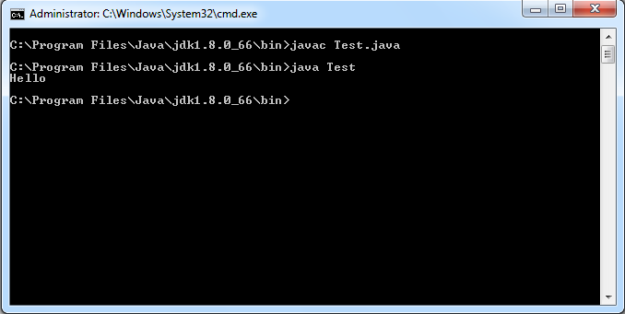
Executing The Code
For example, if class “Test” has the main() method then our command would be:
java Test

Slide 13
QUIZ
How many .class files would be generated for the following code:
class A
{
…………
}
class B
{
………….
}
class C
{
………..
}
Answer: 3

Slide 14
QUIZ
What should be the name of the program:
class A
{
…………
}
class B
{
………….
}
class C
{
………..
}
Answer: Although we can give any name but it is preferred to give the same name as the class which contains main( ) method

Slide 15
QUIZ
What should be the name of the program:
class Indore
{
public static void main(String [ ] args)
{
System.out.println(“In Indore”);
}
}
class Bhopal
{
public static void main(String [ ] args)
{
System.out.println(“In Bhopal”);
}
}
Answer: Can be either “Bhopal.java” or “Indore.java”

Slide 16
QUIZ
In the previous code which main( ) method will be called by JVM if we run our code?
Answer: It depends on how we run the code!
If we run it as:
java Bhopal
Then output would be:
In Bhopal
And , if we run it as:
java Indore
Then output would be:
In Indore

Slide 17
QUIZ
In the previous code what if we want to run both main() methods?
Answer: We will have to call one main() method from the other.
class Indore
{
public static void main(String [ ] args)
{
System.out.println(“In Indore”);
}
}
class Bhopal
{
public static void main(String [ ] args)
{
System.out.println(“In Bhopal”);
Indore.main(null);
}
}
java Bhopal
Output
In Bhopal
In Indore

Slide 18
Another Program
Suppose we write the following code:
class Test
{
public static void main(String [ ] args)
{
System.out.println(“Hello User”);
System.out.println(“Welcome To Java”);
}
}

Slide 19
Another Program
Now when we will run it :
java Test
The output will be:
Hello User
Welcome To Java
Did you notice something ?
The line “Welcome To Java” automatically got displayed on second line . Why?
Because the method println( ) implicitly adds a new line at the end after displaying the message

Slide 20
Another Program
In case we do not want the newline effect then we can use another method called print( ).
So if we write:
System.out.print(“Hello User”);
System.out.print(“Welcome To Java”);
Then the output would be:
Hello UserWelcome To Java

Slide 21
QUIZ
What would be the output of the following code:
System.out.print(“Hello User”);
System.out.println(“Welcome To Java”);
Output:
Hello UserWelcome To Java
This is because the method println( ) method puts a newline after the message not before it.

Slide 22
QUIZ
What would be the output of the following code:
System.out.println(“Hello User”);
System.out.print(“Welcome To Java”);
Output:
Hello User
Welcome To Java

Slide 23
QUIZ
What would be the output of the following code:
System.out.print (“Hello User”);
System.out.println( );
System.out.print (“Welcome To Java”);
Output:
Hello User
Welcome To Java
This is because if we call the method println( ) without
arguments it just generates a newline on console.

Slide 24
QUIZ
What would be the output of the following code:
System.out.print (“Hello User”);
System.out.print( );
System.out.print (“Welcome To Java”);
Output:
Syntax Error!
This is because the method print( ) always requires
arguments , so we cannot call it without
arguments.

Slide 25
Some Common Errors!
There are some very common mistakes which a programmer might make in his code due to which errors arise. These are:
Forgetting to match number of opening and closing braces
Missing the semicolon or Statement terminator
Method main() argurment

Slide 26
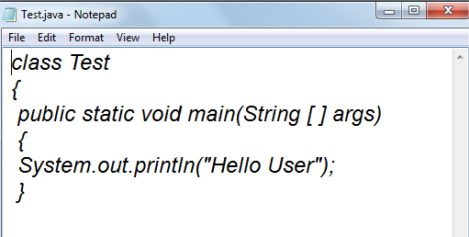
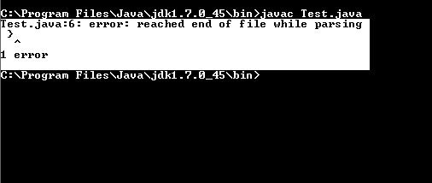
Forgetting to match number of opening and closing braces

Slide 27
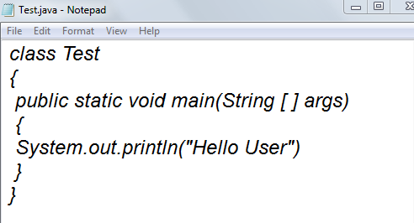
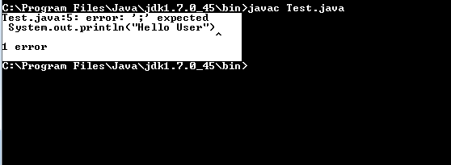
Missing semicolon or Statement Terminator

Slide 28
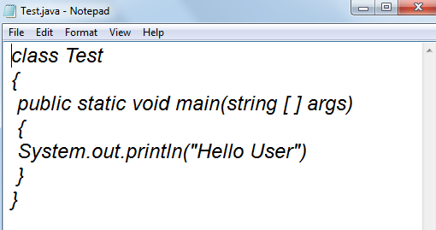
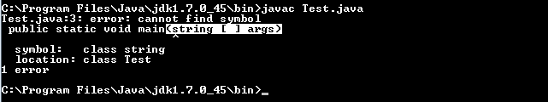
Method main() Argument

Slide 29
Some More Concepts
A very common doubt which might arise in your mind while learning java is that from where we are getting access of “String” and “System” classes.
We know that they are predefined classes but we haven’t included any predefined file in our code(like header files) but still we are able to use “String” and “System” class.
How is it possible?

Slide 30
Some More Concepts
Every java program at minimum should consist of a class.
Outside class no statement is entertained, the source code will not even compile.
Classes with similar functionalities are grouped together and are called as Packages.
In Java, like C++ we don’t have header files, instead Java uses the concept of packages.
A package is just a folder which contains java classes and as of Java 8 there are 217 packages containing 4240 classes.

Slide 31
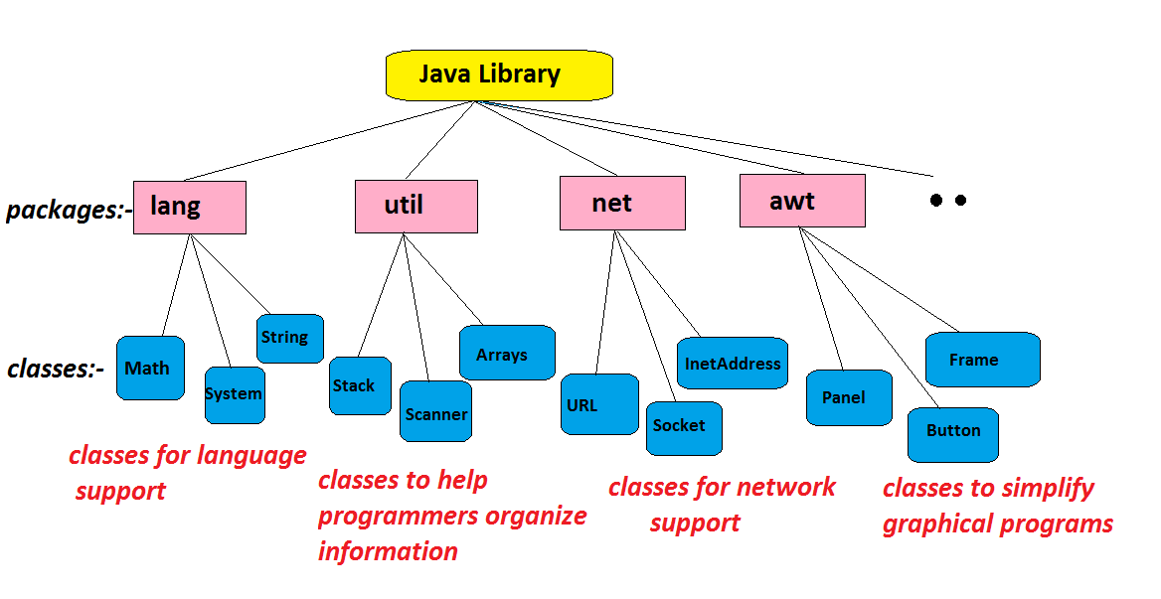
Some Important Packages

Slide 32
Some More Concepts
Amongst these packages there is a package called java.lang which provides classes that are fundamental to the design of the Java programming language.
Since these classes are so essential , the package java.lang is implicitly added to our program by the java compiler itself.
The classes String,System,Math and many more come from this package only.

Slide 33
Some More Concepts
But if we want to add this package ourself then we can do so by writing “import” keyword.
In java to add the support of a package/class in our code we use the keyword import whose general syntax is:
import <package_name>.<class_name>;
OR
import <package_name>.*;
For example:
import java.lang.String;
import java.lang.System;
OR
import java.lang.*;

Slide 34

End Of Lecture 3
For any queries mail us @: scalive4u@gmail.com
Call us @ : 0755-4271659, 7879165533
Agenda for Fourth Lecture:
Data Types
Implicit Type Conversion
Explicit Type Conversion
Type Conversion In Expressions

